Slide 1

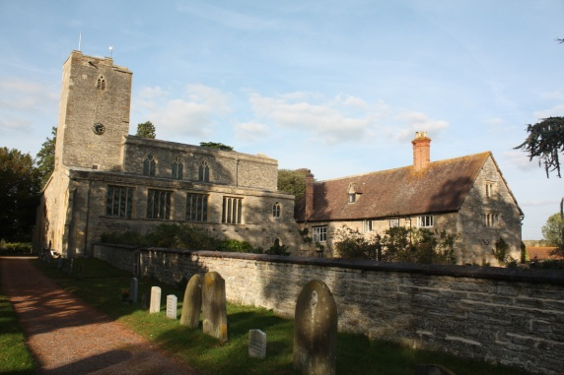

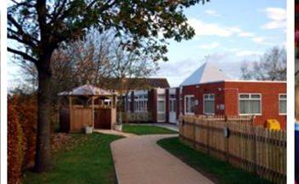
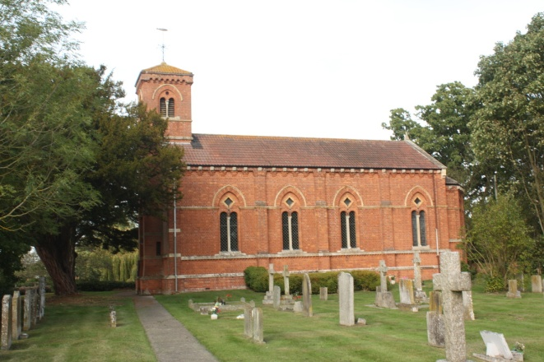
Parent Forum
Aut 2023
Learning and living as children of God
(Ephesians5:1)(You are God’s children whom he loves. Try to be like God)
Jayne Neveu

Slide 2
2023 | Early Years Foundation Stage: % achieving Good Level of Development |  |  |  |  | Phonics Screening Check: % achieving expected standard at end Year 1 |  |  |  |  | Phonics Screening Check: % achieving expected standard at end Key Stage 1
 | 2017 | 2018 | 2019 | 2022 | 2023 | 2017 | 2018 | 2019 | 2022 | 2023 | 2017 | 2018 | 2019 | 2022 | 2023
Glos | 68% | 69% | 72% | 67.4% |  | 79% | 81% |  | 76.9% |  | 92% | 62% | 60%
Nat | 71% | 71% | 72% | 65.2% | 67% | 81% | 82% | 82% | 75.6% | 79% | 92% | 61% | 55.9%
Sch | 80% | 100% | 92% | 90% | 90% | 92% | 100% of those who took it (2 disapplied 79%) | 100% | 100% of those who took test(1 disapplied who arrived week of phonics 92% | 82% | 100% | --- | 100% | Year 2 (Covid year 1s) tested Dec 2021 100% | N/A
2022 GLD Av points – School 33.9, Glos 31.6 Nat 31
2023 GLD Av Points – School 33.8 Glos xxxx Nat xxxx

Slide 3
Glos
Nat
Sch
School - KS1 RWM 2022 EXS+ 90% GDS RWM20%
KS1 Glos RWM 53.7% GDS 5.8%
KS1 Nat RWM 2022 53.4% GDS 5.9%
KS1 2023
KS1 RWM 2023 EXS+ 82% GDS RWM27%
KS1 Glos RWM 2023 xxx GDS xxx
KS1 Nat RWM 2023 56% GDS xxx

Slide 4
KS2 8 pupils 2023 1 pupil = 12.5% |  |  |  |  |  |  |  |  |  |  |  | % pupils achieving at least expected standard and high standard / greater depth
 | Reading |  |  |  |  | Writing |  |  |  |  | Maths |  |  |  |  | GPS |  |  |  |  | Science
 | 2017 | 2018 | 2019 | 2022 | 2023 | 2017 | 2018 | 2019 | 2022 | 2023 | 2017 | 2018 | 2019 | 2022 | 2023 | 2017 | 2018 | 2019 | 2022 | 2023 | 2017 | 2018 | 2019 | 2022 | 2023
Glos: EXS+ High/GDS | 74% 29% | 75% 30% | 74% 30% | 75.4% 29.7% |  | 73% 17% | 76% 20% | 78% 20% | 67.8% 11.1% |  | 75% 23% | 73% 22% | 78% 25% | 70.2% 21.3% |  | 77% 31% | 76% 32% | 78% 34% | 72.8% 27.8% |  | 80% - | 83%
Nat: EXS+ High/GDS | 71% 25% | 75% 28% | 73% 27% | 74.5% 27.8% | 73% | 76% 18% | 78% 20% | 78% 20% | 69.5% 12.9% | 71% | 75% 23% | 76% 24% | 79% 27% | 71.3% 22.4% | 73% | 77% 31% | 78% 34% | 78% 36% | 72.4% 28.3% | 72% | 82% - |  | 83% | 79% | 80%
School EXS+ High/GDS | 91% 36% | 86% 29% | 86% 36% | 91% 45% | 88% 50% | 100% 36% | 100% 43% | 93% 36% | 82% 27% | 100% 50% | 82% 27% | 71% 29% | 93% 36% | 82% 45% | 100% 25% | 91% 36% | 71% 43% | 86% 36% | 81.8% 27.3% | 75% 37% | 100% | 100% | 93% | 82% | 100%
2022- Average Scaled scores
GPS – School 105.5, Glos 105.1, Nat 105.1
Reading - School 108.5, Glos 105, Nat 104
Maths - School 108.4, Glos 103.6, Nat 103.8
2023- Average Scaled scores
GPS – School 107, Glos xxx, Nat105
Reading - School 109, Glos xxx, Nat 105
Maths - School 106, Glos xxx, Nat 104

Slide 5
To continue to maintain and continue to build on teaching and Learning outcomes
To continue to diminish the gap of all vulnerable groups including the lowest 20% of learners
To continue to embed standards in Reading, Writing and Maths
To continue to use opportunities of NTP and SLT
To continue with marking and feedback to challenge children and address misconceptions,
To work towrads IT QM
To continue to monitor use of Pupil Premium funding and ensure progress and attainment of vulnerable groups (FSM, FSM6, CLA, SC, )
To continue to promote reading across school, maintain a rigorous approach to teaching it and link with phonics (Early years reading), ensure EEF support for reading tips is given to parents at the start of the academic term
Current Priorities 2023-24
.

Slide 6
To continue to raise profile of mental health and well-being for staff and pupils
Children to continue to identify Biblical origins in relation to school values
To continue to monitor funding for pre school
To add emergency lights to fire exits
To work towards toilet refurbishment - long term
To continue to monitor financial implications of after school child care club
Current Priorities 2023-24
To achieve sports school award again

Slide 7
Creativity and Enrichment and Over Learning and Cultural Capital Opportunities 2022-23
 | Autumn Football club 1-6 | Spring | Summer
EYFS | The Nativity Carol concert Balanceability Pets as Therapy Enterprise Theatre visit EFRA – First Aid Diwali Dance Forest School | Prayer Space Dance coach Economy talk – Lloyds bank Indian traditional clothes - dressing Forest SchooI Ukulele Pets as Therapy iSingPOP | School Play Art Day Forest School Cricket enrichment Day Skills Zone Day - safety
Year 1 /2 | Carol concert Pets as Therapy Enterprise Science club Theatre visit Football club 1-6 Ball skills club EFRA – First Aid Diwali Dance Lego club – y1 Camp Kindness Forest School | Camp Kindness Prayer Space Ukulele Dance coach Economy talk – Lloyds bank Indian cooking Forest School iSingPOP Pets as Therapy | School Play Art Day Forest School Board Games club Football club Camp Kindness Cricket Club Cricket enrichment Day Skills Zone Day- safety
Year 3/4 | Carol Concert Rugby- Glos heritage Pets as Therapy Enterprise Theatre visit Camp Kindness – club Football club 1-6 EFRA – First Aid Diwali Dance English Heritage – Glos Hartpury Art Club (y4) Trip – science lab and library Forest School | Prayer Space Dance coach STEM K’Nex Economy talk – Lloyds bank Hinduism workshop Orienteering Forest School iSINGPOP Pets as Therapy | School Play Art Day Football club Forest School Cricket Club Parliamentary workshop Cricket enrichment Day Art Club In the Net
Year 5/6 | Carol concert Croft Farm – team building Pets as Therapy Macmillan Coffee morning Enterprise Theatre visit Football club 1-6 Multisport club Think Tank Trip EFRA – First Aid Diwali Dance Art Club Forest School | Board Games - club Prayer Space STEM STEM K’Nex Economy talk – Lloyds bank Hinduism workshop Forest School ISingPOP Pets as Therapy | School Play Art Day Forest School STEM National Challenge Rounders – coaching Science Club Football Club Cricket Club Parliamentary workshop Cricket enrichment Day Tewkesbury Medieval Festival Online safety – Glos Police

Slide 8
General
PE kits need to be in school – regardless of day
Forest school clothing
Contributions to school activities
Attendance and punctuality – lessons start at 8.45
Clothes need to be labelled
Cater Cater lunches
Online safety - website

Slide 9
Little Deers
LDs continues to be successful and offers lovely opportunities for children to learn through play.
Thank you to everyone who organises the fundraising events, this is so important to us.

Slide 10
Questions

Slide 11
Our vision remains stronger than ever
Learning and living as children of God
(Ephesians5:1)(You are God’s children whom he loves. Try to be like God)
We serve our community by providing the highest quality education, encouraging understanding of faith and promoting Christian values. All children can express curiosity, explore big questions, share socially and spiritually with freedom to make good choices underpinned by our values. Respect, Friendship, Perseverance, Thankfulness, Trust and Truthfulness and our shadow values of Compassion, Courage, Forgiveness, Generosity, Justice and Service
Thank you for coming

