Slide 1
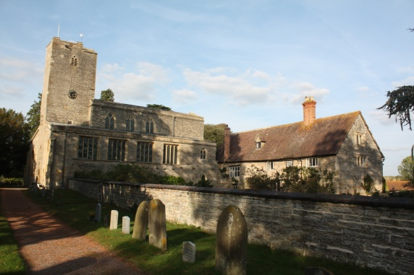
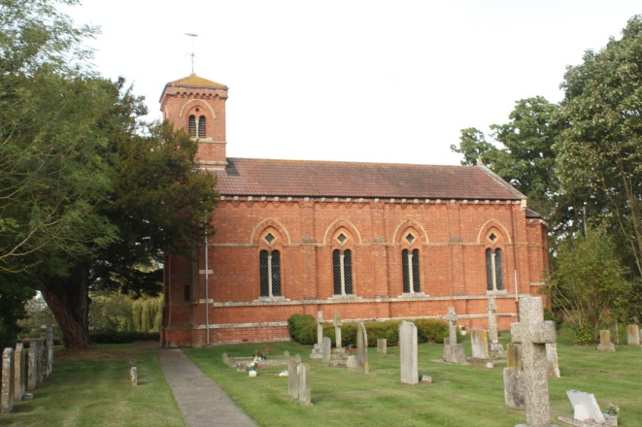
Parent Forum
Aut 2022
Learning and living as children of God (Ephesians5:1)(You are God’s children whom he loves. Try to be like God)
Jayne Neveu

Slide 2
 | Early Years Foundation Stage: % achieving Good Level of Development |  |  |  | Phonics Screening Check: % achieving expected standard at end Year 1 |  |  |  | Phonics Screening Check: % achieving expected standard at end Key Stage 1
 | 2017 | 2018 | 2019 | 2022 | 2017 | 2018 | 2019 | 2022 | 2017 | 2018 | 2019 | 2022
Glos | 68% | 69% | 72% | 67.4% | 79% | 81% |  | 76.9% | 92% | 62% | 60%
Nat | 71% | 71% | 72% | 65.2% | 81% | 82% | 82% | 75.6% | 92% | 61% | 55.9%
Sch | 80% | 100% | 92% | 90% | 92% | 100% of those who took it (2 disapplied 79%) | 100% | 100% of those who took test(1 disapplied who arrived week of phonics 92% | 100% | --- | 100% | Year 2 (Covid year 1s) tested Dec 2021 100%
2022 GLD Av points – School 33.9, Glos 31.6 Nat 31

Slide 3
KS1 (10 pupils 2022)LA moderated | % pupils achieving at least expected standard and greater depth
 | Reading |  |  | Writing |  |  | Maths |  |  | Science
 | 2018 | 2019 | 2022 | 2018 | 2019 | 2022 | 2018 | 2019 | 2022 | 2018 | 2019 | 2022
Glos: EXS+ GDS | 75% 26% | 75% 26% | 68.1% 19.3% | 69% 14% | 67% 14% | 58.3% 8.1% | 75% 20% | 74% 21% | 68.4% 15.7% | 84% - |  | 79.9%
Nat: EXS+ GDS | 75% 25% | 75% 25% | 67% 18% | 70% 16% | 69% 15% | 57.7% 8% | 76% 22% | 76% 22% | 67.7% 15.1% | 83% - | 82% | 77.1%
School EXS+ GDS | 90% 50% | 89% 44% | EXS+ 100% GDS 70% | 90% 40% | 89% 33% | WTS 10% EXS + 90% GDS 30% | 90% 40% | 89% 33% | WTS 10% EXS+ 90% 30% | 100% | 89% | EXS 100%
School - KS1 RWM 2022 EXS+ 90% GDS RWM20%
KS1 Glos RWM 53.7% GDS 5.8%
KS1 Nat RWM 2022 53.4% GDS 5.9%

Slide 4
KS2 111 pupils 2022 1 pupil = 9% |  |  |  |  |  |  |  | % pupils achieving at least expected standard and high standard / greater depth
 | Reading |  |  |  | Writing |  |  |  | Maths |  |  |  | GPS |  |  |  | Science
 | 2017 | 2018 | 2019 | 2022 | 2017 | 2018 | 2019 | 2022 | 2017 | 2018 | 2019 | 2022 | 2017 | 2018 | 2019 | 2022 | 2017 | 2018 | 2019 | 2022
Glos: EXS+ High/GDS | 74% 29% | 75% 30% | 74% 30% | 75.4% 29.7% | 73% 17% | 76% 20% | 78% 20% | 67.8% 11.1% | 75% 23% | 73% 22% | 78% 25% | 70.2% 21.3% | 77% 31% | 76% 32% | 78% 34% | 72.8% 27.8% | 80% - | 83%
Nat: EXS+ High/GDS | 71% 25% | 75% 28% | 73% 27% | 74.5% 27.8% | 76% 18% | 78% 20% | 78% 20% | 69.5% 12.9% | 75% 23% | 76% 24% | 79% 27% | 71.3% 22.4% | 77% 31% | 78% 34% | 78% 36% | 72.4% 28.3% | 82% - |  | 83%
School EXS+ High/GDS | 91% 36% | 86% 29% | 86% 36% | 91% 45% | 100% 36% | 100% 43% | 93% 36% | 82% 27% | 82% 27% | 71% 29% | 93% 36% | 82% 45% | 91% 36% | 71% 43% | 86% 36% | 81.8% 27.3% | 100% | 100% | 93% | 82%
2022- Average Scaled scores
GPS – School 105.5, Glos 105.1, Nat 105.1
Reading - School 108.5, Glos 105, Nat 104
Maths - School 108.4, Glos 103.6, Nat 103.8

Slide 5
To continue to maintain and continue to build on teaching and Learning outcomes
To continue to diminish the gap of all vulnerable groups including the lowest 20% of learners
To continue to embed standards in Reading, Writing and Maths
To continue to use opportunities of NTP and SLT
To continue with marking and feedback to challenge children and address misconceptions,
To continue to ensure the curriculum is coherently planned and sequenced, broad and balanced
To continue to promote reading across school, maintain a rigorous approach to teaching it and link with phonics (Early years reading), ensure EEF support for reading tips is given to parents at the start of the academic term
Current Priorities 2022-23
.

Slide 6
To continue to raise profile of mental health and well-being
To ensure Ukrainian children joining us have access to the English curriculum
To Continue to ensure the Governors remain an active part of the school community and continue to develop their understanding of the curriculum and progression
To continue to monitor use of Pupil Premium funding and ensure progress and attainment of vulnerable groups (FSM, FSM6, CLA, SC, )
To continue tracking of foundation subjects (Ofsted point Jan 2018) - ongoing
Current Priorities 2022-23
To achieve sports school award once again - Platinum

Slide 7
To further embed planning of worship by pupils and continue to lead (SIAMs) – linking to children’s own ‘
To continue to work on achieving the PSQM
Children to continue link Biblical references when discussing values
To continue develop Eco School
Continue to challenge more able (prior higher attainers+)with provision made in class maintaining higher attainment bracket (deeper learning/solve it opportunities) at end of KS1 and KS2 national standards (linked to Marking and Feedback)
To continue to hold Parent Forums
Current Priorities 2022-23

Slide 8
To monitor use of After School Childcare club to ensure it is viable
To plan for future reading/wellbeing hub
To plan for changing of dining tables
To plan for replacing IPads
Work towards refurbishing the toilet block
To continue moderation/links with Pre-School and continue to build on EYFS outcomes for the new (2021) EYFS profile of the Education programme
To continue to monitor use of Pre-School
Current Priorities 2022-23
To improve areas in need of maintenance around school
Helpful Notes
Disadvantaged – Free School Meal Children PP
Vulnerable groups – Children with Special Educational Needs
GB – Governing Body
PSQM – Primary Science Quality Mark

Slide 9
Creativity and Enrichment and Over Learning and Cultural Capital Opportunities 2022-23
Clubs | Autumn Football club 1-6 Camp Kindness Lego Multi sport Science Football | Spring | Summer
EYFS | The Nativity Carol concert Balanceability Pets as Therapy Enterprise Theatre visit Diwali Dance coach First Aid | Prayer Space Dance coach | Nature in Art visit Art Day
Year 1 /2 | Carol concert Pets as Therapy Enterprise Science club Theatre visit Football club 1-6 Ball skills club Diwali Dance coach Lego club First Aid | Camp Kindness Prayer Space Ukulele Dance coach | Nature in Art visit Art Day
Year 3/4 | Carol Concert Rugby- Glos heritage Pets as Therapy Enterprise Theatre visit Camp Kindness – club Football club 1-6 Diwali Dance coach First Aid | Prayer Space Dance coach | Nature in Art visit Art Day
Year 5/6 | Carol concert Croft Farm – team building Pets as Therapy STEM Macmillan Coffee morning Enterprise Theatre visit Football club 1-6 Multisport club Diwali Dance coach Art Club STEM workshop First Aid | Board Games - club Prayer Space | Nature in Art visit Art Day

Slide 10
Questionnaire
 | 35 forms returned | Strongly agree | Agree | Disagree | Strongly disagree | Don’t know
1 | My child is happy at school | 80% 28 | 17% 6 | 2% 1
2 | My child feels safe at this school | 30 86% | 11% 4 |  |  | 1 2%
3 | The school makes sure its pupils are well behaved | 80% 28 | 20% 7
4 or | My child has been bullied and the school dealt with the bullying quickly and effectively ( habitually cruel, insulting, or threatening to others) |  | 2% 1 |  |  | 1 2%
4a | My child has not been bullied at this school | 95% 33
5 | The school makes me aware of what my child will learn during the year | 29 83% | 6 17%
6 or | When I raise concerns with the school they have been dealt with properly | 18 52% | 2 4%
6a | I have not raised any concerns with school | 44%
7 | Does your child have SEND? (on a My Plan, My Plan + or EHCP) Yes/No | 91%
7b | My child has SEND and the school gives them the support they need to succeed | 9%
8 | The school has high expectations for my child | 25 71% | 8 23% |  |  | 2 6%
9 | My child does well at this school | 26 74% | 7 20% |  |  | 2 6 %
10 | The school lets me know how my child is doing | 24 69% | 8 23% |  |  | 3 9%
11 | The is a good range of subjects (curriculum coverage – on your topic webs and website) available to my child at this school | 24 69% | 10 29% |  |  | 1 3%
12 | My child can take part in clubs and activities at this school (Y1-Y6) | 21 60% | 10 29% |  |  | 4 N/A
13 | The school supports my child’s wider personal development | 25 71% | 9 26% |  |  | 1 3%
14 | I would recommend this school to another parent (yes/No) | 100%
 | Additional comments:
Name Please Print (Optional)

Slide 11
General
PE kits need to be in school – regardless of day
Forest school clothing
Contributions to school activities
Attendance and punctuality
Clothes need to be labelled
Cater Cater lunches
Online safety - website

Slide 12
Little Deers
LDs continues to be successful and offers lovely opportunities for children to learn through play.
Thank you to everyone who organises the fundraising events, this is so important to us.

Slide 13
Questions

Slide 14
Our vision remains stronger than ever Learning and living as children of God (Ephesians5:1)(You are God’s children whom he loves. Try to be like God) We serve our community by providing the highest quality education, encouraging understanding of faith and promoting Christian values. All children can express curiosity, explore big questions, share socially and spiritually with freedom to make good choices underpinned by our values. Respect, Friendship, Perseverance, Thankfulness, Trust and Truthfulness and our shadow values of Compassion, Courage, Forgiveness, Generosity, Justice and Service
Thank you for coming

