Slide 1



Parent Forum
17th June 2025
Welcome
Jayne Neveu

Slide 2
Our year – a fantastic one!
Update - structure
Budget
Awards
SDP 2024-25

Slide 3
Current Context
Boys 40% Girls; 60% SEND 18% FSM 11%
Four Class structure and Pre School
Next academic year:

Slide 4
Clubs
School offers a variety of clubs some of which are paid for. We also try to opt in for any offers of paid clubs. Over the course of the year clubs are offered to each year group, with the exception of Reception Class.

Slide 5
Incidentals
Please remember to label clothes/equipment
Homework, it is important to continue to support your child with homework and if you need support contact school
Homework is on the website, including all spelling lists
Correspondence – we try our very best to send letters, newsletter reminders and chalk board messages. This is done efficiently but some parents are misplacing letters so please try to make a note of dates that are relevant to you.
Trips and payment
Parent Pay - deadlines

Slide 6
Funding
We are a small school and just like any other school we need to keep a tight budget
We will continue to organise trips and request voluntary contributions but we may have to review them if we don’t get regular contributions

Slide 7
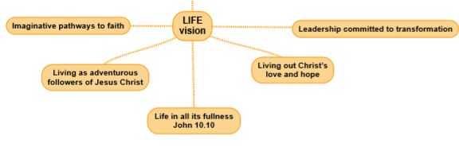
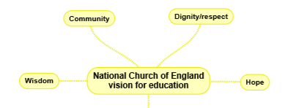
School Vision
‘Learning to live as children of God’
We serve our community by providing the highest quality education, encouraging understanding of faith and promoting Christian values. All children can express curiosity, explore big questions, share socially and spiritually with freedom to make good choices underpinned by our values. Respect, Friendship, Perseverance, Thankfulness, Trust and Truthfulness and our shadow values of Compassion, Courage, Forgiveness, Generosity, Justice and Service
SIAMs – Update – Excellent judgement 2023
Statutory Inspection of Anglican and Methodist Schools

Slide 8
Statutory Outcomes | D&A% of pupils at EXS 2022 | D&A% of pupils at GDS 2022 | National % at EXS 2022 | National % at GDS 2022 | D&A% of pupils at EXS 2023 | D&A% of pupils at GDS 2023 | National % at EXS 2023 | National % at GDS 2023 | D&A% of pupils at EXS 2024 | D&A% of pupils at GDS 2024 | National % at EXS 2024 | National % at GDS 2024
KS2 Reading | 91% | 45% | 74% | 28% | 88% | 50% | 73% | 29% | 100% | 50% | 74% | 28%
KS2 Writing | 82% | 27% | 69% | 13% | 100% | 50% | 71% | 13% | 100% | 30% | 72% | 13%
KS2 Maths | 82% | 45% | 71% | 22% | 100% | 25% | 73% | 24% | 90% | 30% | 73% | 24%
KS2 Grammar | 82% | 27% | 72% | 28% | 75% | 37% | 72% | 30% | 80% | 30% | 72% | 32%
KS2 Science | 82% | N/A | 79% | N/A | 100% |  | 80% |  | 100% |  | 81%
KS2 RWM | 82% | 18% | 59% | 7% | 88% | 25% | 60% | 8% | 90% | 20% | 61% | 8%

Slide 9
Statutory Outcomes | % of pupils at EXS National 2022 | % of pupils at Glos 2022 | School % at EXS 2022 |  | % of pupils at EXS National 2023 | % of pupils at Glos 2023 | School % at EXS 2023 |  | % of pupils at EXS National 2024 | % of pupils at Glos 2024 | School % at EXS 2024
EYFS (GLD) | 65% | 67% | 90% |  | 67% | 67% | 90% |  | 68% | 68% | 92%%

Slide 10
Statutory Outcomes | % of pupils at Nat EXS 2022 | % of pupils at Glos 2022 | School % at 2022 |  | % of pupils at Nat EXS 2023 | % of pupils at Glos 2023 | School % at 2023 |  | % of pupils at Nat EXS 2024 | % of pupils at Glos 2024 | School % at 2024
Y1 Phonics | 75% | 77% | 100% |  | 79% | 79% | 82% |  | 80% | 80% | 80%
Y2 Phonics | 87% |  | 100% (Covid year) |  | 89% |  |  |  |  | 56% | 0% (2)

Slide 11
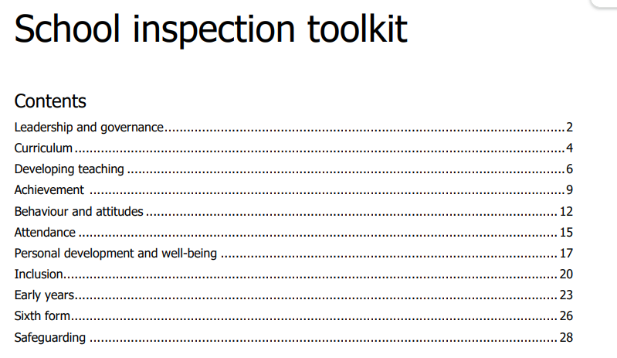
Ofsted- Current Second Judgement – Outstanding(last judgement carried out under Section 8 Ungraded – Aut 25 changes to report cards Inspection

Slide 12
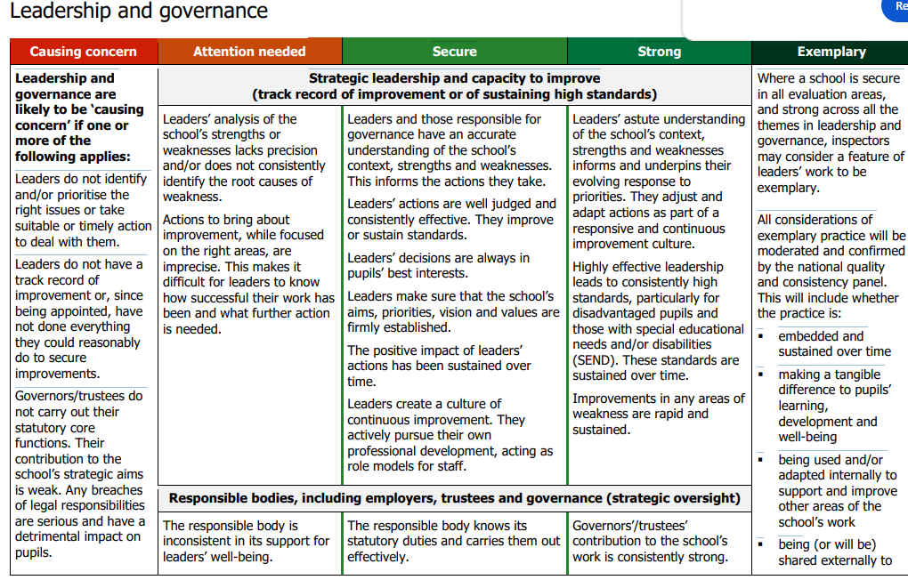
Example of part of L&M

Slide 13
Any questions?
Thank you for your continued support!

