Slide 1
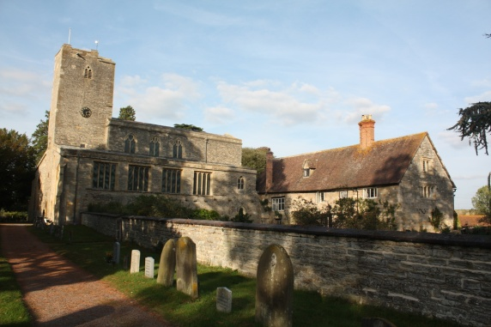
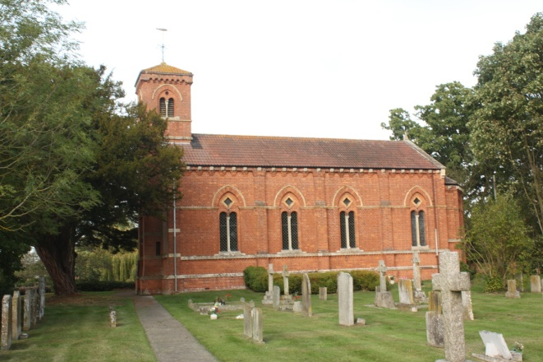
Parent Forum
16th October 2019
Jayne Neveu

Slide 2
KS1 Deerhurst in KS2 National Tests achieved 86%RWM (2019) National comparisons RWM 75%
Reading 89%
Nationally: 75%
Writing 89%
Nationally: 69%
Maths 89%
Nationally: 76%
FSM 100% ALL ks1 subjects
KS2 summary: D&A
GPs 86% exs, fsm 100% GDS 36%
National: 65% RWM Deerhurst & Apperley86% RWM
Writing 93% Exs, fsm 50% SEN 0% GDS 36%
National :writing 78% 20%
Maths 93% Exs, Fsm50% (2) Sen 0% (1) GDS 36%
National: Maths 79% GDS 27%
Reading86% Exs, fsm 50%(2) Sen 0% (1) GDS 36%
National: Reading 73%
EYFS:
The county GLD for 2019 was 72% D&A 92%
Phonics 100% Nat 82%

Slide 3
Little Deers
Three days of opening is very strong and remains to be so. Jenny and Sandra work relentlessly at providing a wonderful experience for the pre-school children. Thank you to everyone who organises the fundraising events.

Slide 4
Budgets and Funding
Last year school was capped £32,000 and the previous year £39,000. This is a result of fairer funding. At the time of writing this document I have had no notice about future funding. Budgets are always tight.

Slide 5
To continue to maintain and build on teaching and Learning outcomes
To continue to diminish the gap for vulnerable children and raise standards in reading, writing, and maths for the lowest 20% of pupils across all year groups. .
To re-visit the curriculum and continue to ensure it is coherently planned and sequenced
To continue with marking and feedback to challenge children and address misconceptions, systematically
Continue to raise standards writing, reading and maths)
Reading to be done everday with parents for at least 15 minutes per day and continue with 'soft entry' to school
Current Priorities 19/20

Slide 6
To continue to develop RE in school in line with the RE agreed syllabus and Christianity Project
To ensure equality of GDS for any gender inequality
Children to continue link Biblical references when discussing values
To audit and evaluate worship inline with thelatest SIAMs schedule
Challenge more able (prior higher attainers+)with provision made in class maintaining higher attainment bracket (deeper learning) at end of KS1 and KS2 national standards
Promote schools new vision
Current Priorities 19/20

Slide 7
Link Sports Premium funding to develop wellbeing and mental health
To continue to develop the role of Subject Leader s and support other schools with our best practise.
To Continue to develop GB involvement in the life of the school
Collate evidence of progress of disadvantaged children to allow for small steps.
To continue to promote reading across school, maintain a rigorous approach to teaching it and link with phonics (Early years reading)
Current Priorities 19/20
To achieve Gold Sports Award for 5th time to obtain Platinum and continue to explore new sport in school

Slide 8
To continue to build links of transition with pre-school including moderation and shared days
GB newsletters to continue
To raise profile of mental health and well-being
Continue to monitor Pre-School numbers and funding
Plan replacement or fixture of some Trim trail posts identified as needing replacement in the future
To continue to develop Building Learning for impact on learning
Current Priorities 19/20

Slide 9
Budget for further fencing at the front of the school
To take part in the DFE Fibre BB option (part funded)
To rejoin a sports network for further opportunities
Investigate outdoor gym and possibly replacement Trim Trial
To plan for replacement Elliot building and school roof – Long term Bid for funding
To continue to develop Parent Communication at Deerhurst through the role of Parent Forum
Current Priorities 19/20

Slide 10
General
PE kits need to be in school
Contributions to school activities
Attendance and punctuality
Clothes need to be labelled
Photography
On line

Slide 11
Rich Curriculum Experiences 2018-19
There have been many
PGL
Christmas theatre
Cricket coaching
Dance studio experience
Language day and food tasting
STEM engineering experience
Science competition and presentation at Bristol uni
Water safety theatre
Police and fire engine visit
Farm visit
Nature in Art visit
Scooter club, netball club, football club
Medieval festival
Maths challenge experience
Ising Pop
Trombone experience
Harpist experience
Drumming workshop
In the net experience
Cheltenham festival
Village hall experience
Paralympian gymnast

Slide 12
Our vision remains stronger than ever Learning and living as children of God (Ephesians5:1)(You are God’s children whom he loves. Try to be like God) We serve our community by providing the highest quality education, encouraging understanding of faith and promoting Christian values. All children can express curiosity, explore big questions, share socially and spiritually with freedom to make good choices underpinned by our values. Respect, Friendship, Perseverance, Thankfulness, Trust and Truthfulness and our shadow values of Compassion, Courage, Forgiveness, Generosity, Justice and Service

